Slide 1
FIRE Algorithm
“The approach of CT-FIRE combines the advantages of the fast discrete curvelet transform for denoising images, enhancement of the fiber edge features, and the fiber extraction (FIRE) algorithm for extracting individual fibers.” - Andrew et al.

Slide 2
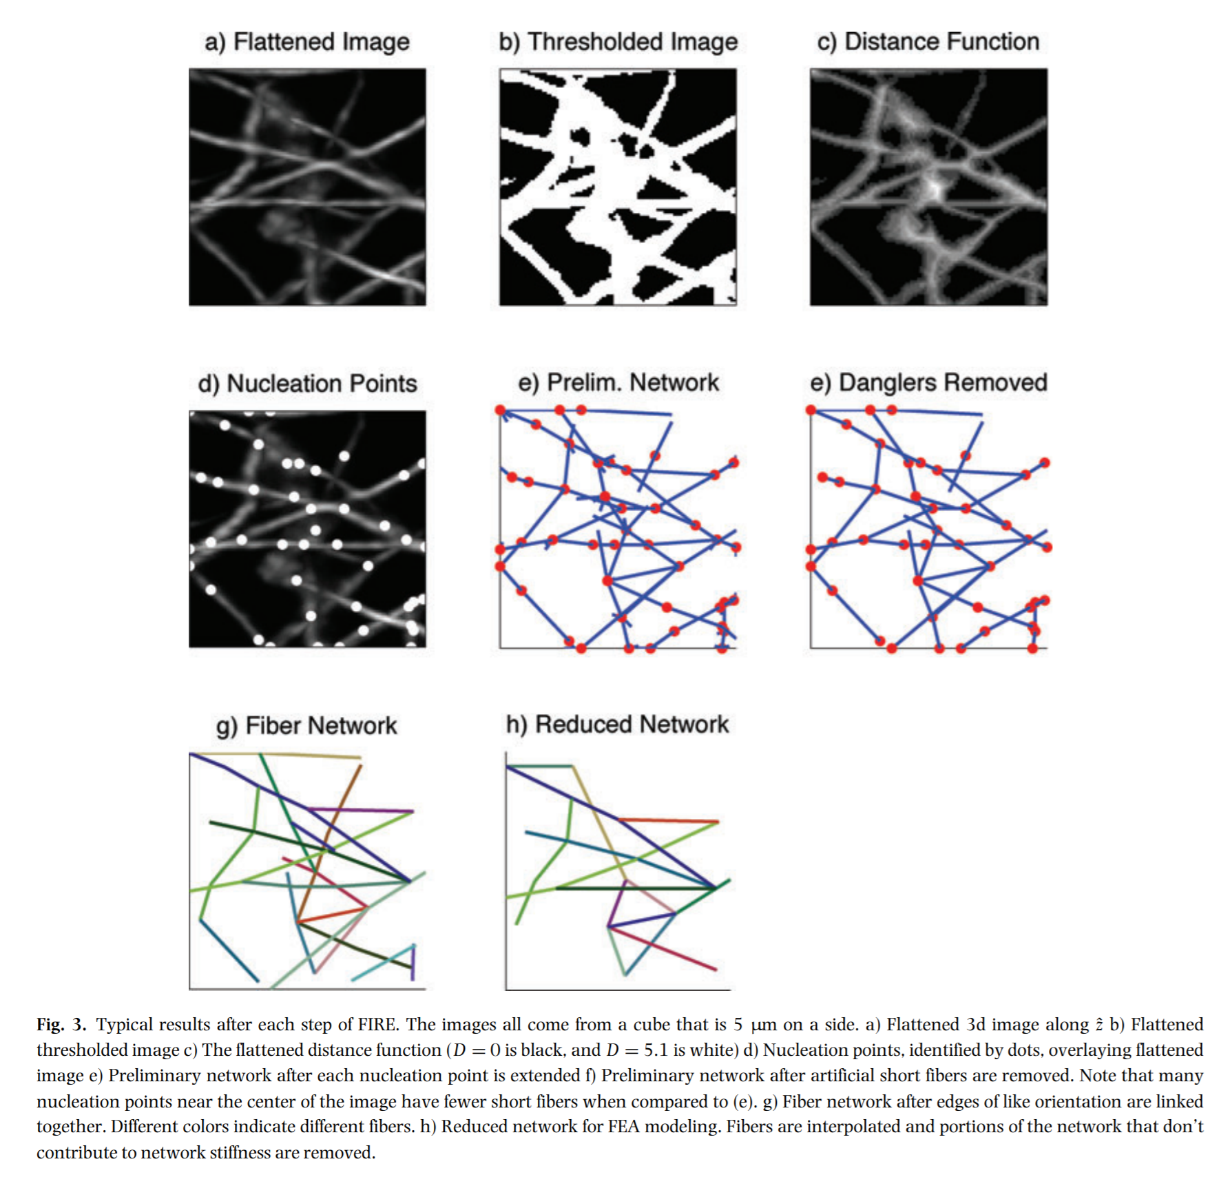
Flatten z-stacks along the axis perpendicular to focal plane.
Binary threshold on the image, into foreground vs background. Use relative intensity of pixels
Determine the minimum distance of each foreground pixel to the background. Apply a Gaussian filter.
Select nucleation points in the image to be the pixels with the maximum distance values.
Find the local maximum points (LMPs) of each nucleation points in a similar fashion. Continue to build the network until no more LMPs are found.
Remove short dangling fibers.

Slide 3
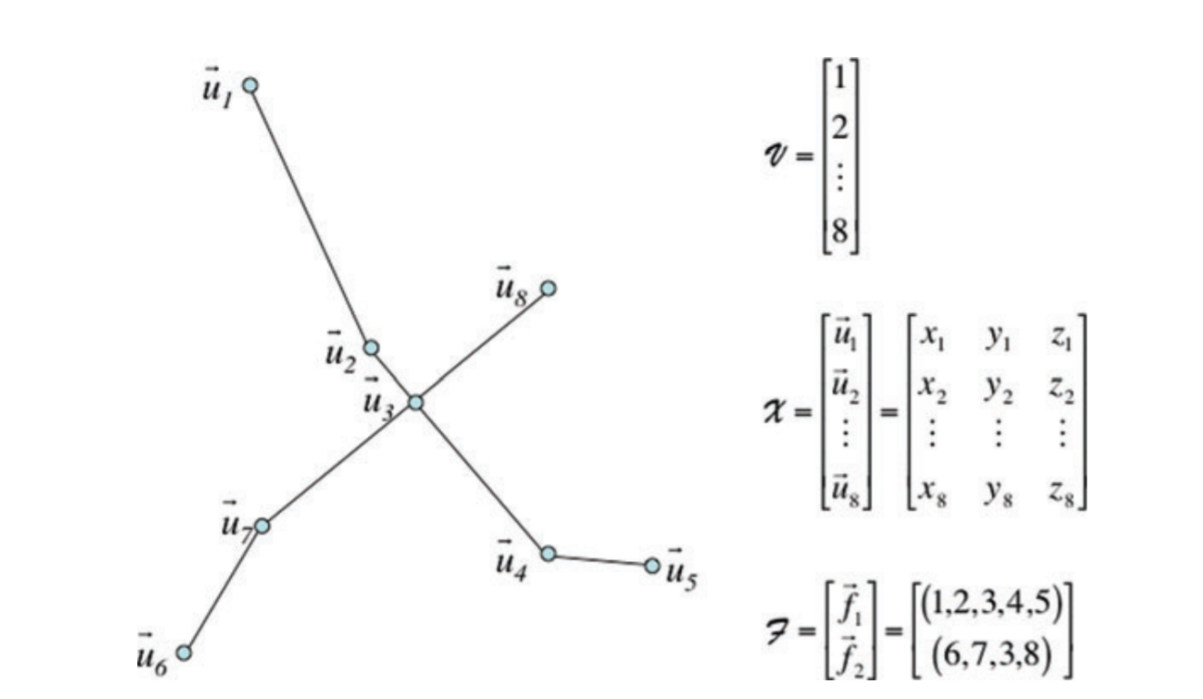
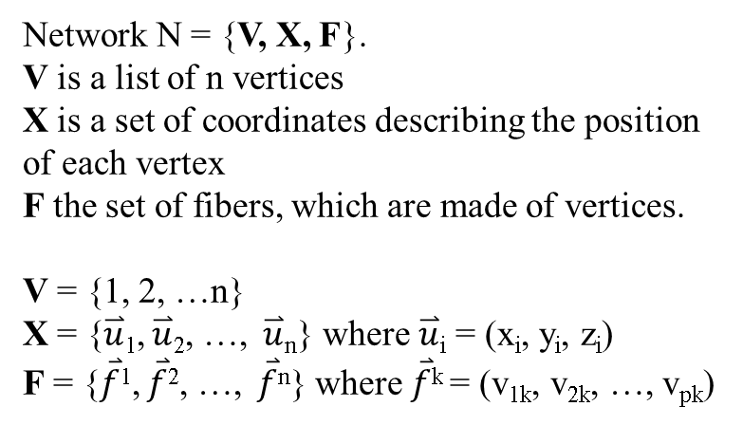
Network N = {V, X, F}.
V is a list of n vertices
X is a set of coordinates describing the position of each vertex
F the set of fibers, which are made of vertices.
V = {1, 2, …n}
X = {$\overset{⃑}{u}$₁, $\overset{⃑}{u}$₂, …, $\overset{⃑}{u}$_{n}} where $\overset{⃑}{u}$_{i} = (x_{i}, y_{i}, z_{i})
F = {$\overset{⃑}{f}$¹, $\overset{⃑}{f}$², …, $\overset{⃑}{f}$^{n}} where $\overset{⃑}{f}$^{k} = (v_{1k}, v_{2k}, …, v_{pk})

Slide 4
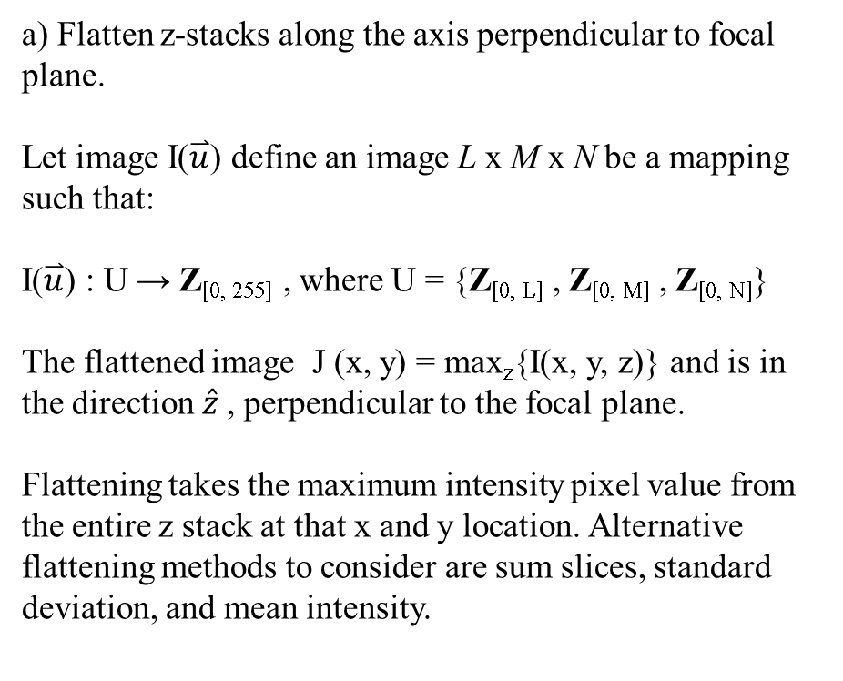
a) Flatten z-stacks along the axis perpendicular to focal plane.
Let image I($\overset{⃑}{u}$) define an image L x M x N be a mapping such that:
I($\overset{⃑}{u}$) : U → Z_{[0, 255]} , where U = {Z_{[0, L]} , Z_{[0, M]} , Z_{[0, N]}}
The flattened image J (x, y) = max_{z}{I(x, y, z)} and is in the direction $\hat{z}$, perpendicular to the focal plane.
Flattening takes the maximum intensity pixel value from the entire z stack at that x and y location. Alternative flattening methods to consider are sum slices, standard deviation, and mean intensity.
b) Binary threshold on the image, into foreground vs background. Use relative intensity of pixels
Apply a gaussian filter and binarize the image, so that pixel values are 1 if the pixel is a curvelet, else 0.
To binarize, all pixels that are brighter than a certain threshold are 1.
This threshold must be experimentally determined to maintain network topology.

Slide 5
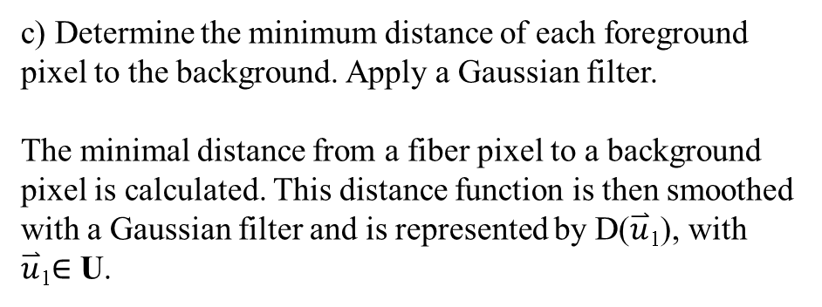
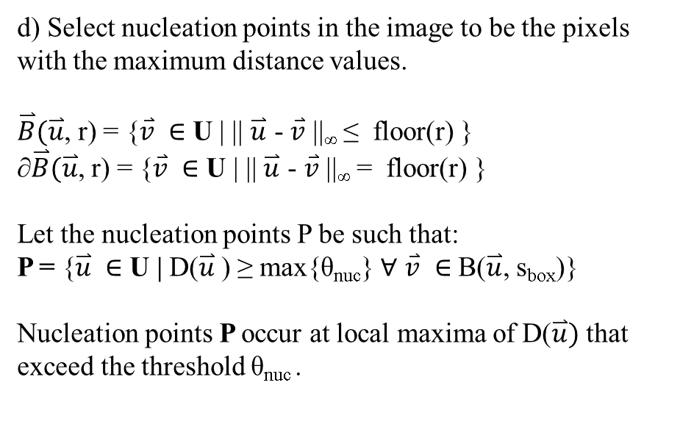
c) Determine the minimum distance of each foreground pixel to the background. Apply a Gaussian filter.
The minimal distance from a fiber pixel to a background pixel is calculated. This distance function is then smoothed with a Gaussian filter and is represented by D($\overset{⃑}{u}$₁), with $\overset{⃑}{u}$₁$∈$ U.
d) Select nucleation points in the image to be the pixels with the maximum distance values.
$\overset{⃑}{B}(\overset{⃑}{u}$, r) = {$\overset{⃑}{v} ∈$ U | || $\overset{⃑}{u}$ - $\overset{⃑}{v}$ ||∞ ≤ floor(r) }
∂$\overset{⃑}{B}(\overset{⃑}{u}$, r) = {$\overset{⃑}{v} ∈$ U | || $\overset{⃑}{u}$ - $\overset{⃑}{v}$ ||∞ = floor(r) }
Let the nucleation points P be such that:
P = {$\overset{⃑}{u} ∈$ U | D($\overset{⃑}{u}$) ≥ max{θ_{nuc}} $∀$ $\overset{⃑}{v} ∈$ B($\overset{⃑}{u}$, s_{box})}
Nucleation points P occur at local maxima of D($\overset{⃑}{u})$ that exceed the threshold θ_{nuc} .

Slide 6
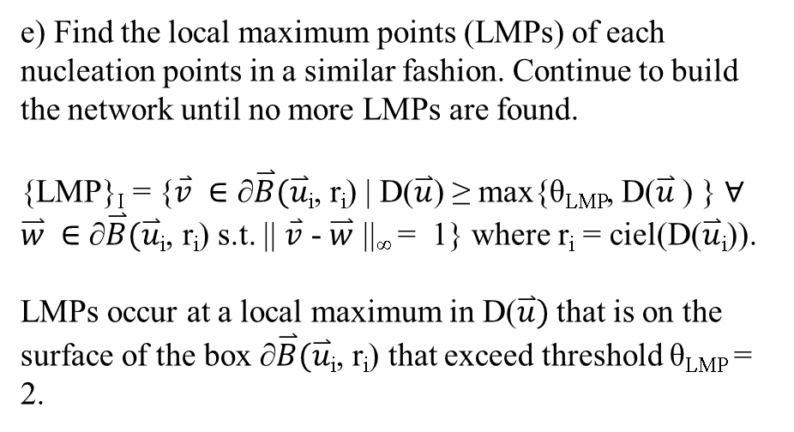
e) Find the local maximum points (LMPs) of each nucleation points in a similar fashion. Continue to build the network until no more LMPs are found.
{LMP}_{I} = {$\overset{⃑}{v} ∈$ ∂$\overset{⃑}{B}(\overset{⃑}{u}$_{i}, r_{i}) | D($\overset{⃑}{u}$) ≥ max{θ_{LMP}, D($\overset{⃑}{u}$) } $∀$ $\overset{⃑}{w} ∈$ ∂$\overset{⃑}{B}(\overset{⃑}{u}$_{i}, r_{i}) s.t. || $\overset{⃑}{v}$ - $\overset{⃑}{w}$ ||∞ = 1} where r_{i} = ciel(D($\overset{⃑}{u}$_{i})).
LMPs occur at a local maximum in D($\overset{⃑}{u})$ that is on the surface of the box ∂$\overset{⃑}{B}(\overset{⃑}{u}$_{i}, r_{i}) that exceed threshold θ_{LMP} = 2.
f) Remove short dangling fibers.
Dangling fibers have a length bellow a certain threshold, and a tangent angel differing from other incoming fiber ends. Fibers that are similar in orientation are joined.

Slide 7
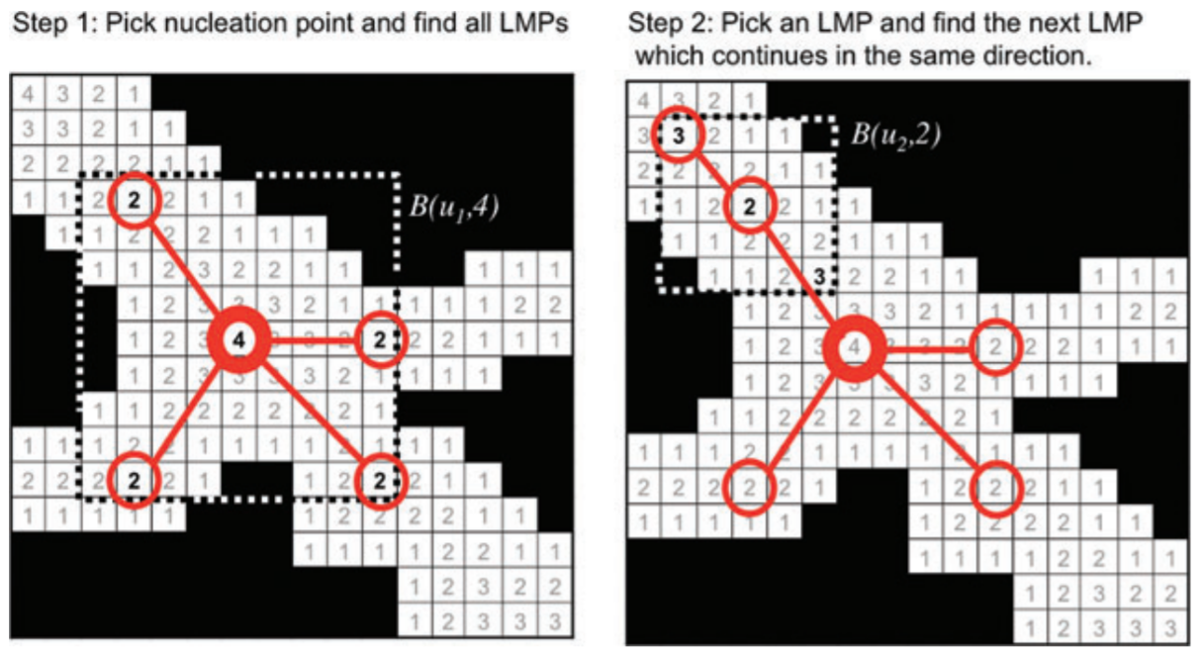
Nucleation and Local Maximum Points (LMPs)

Slide 8
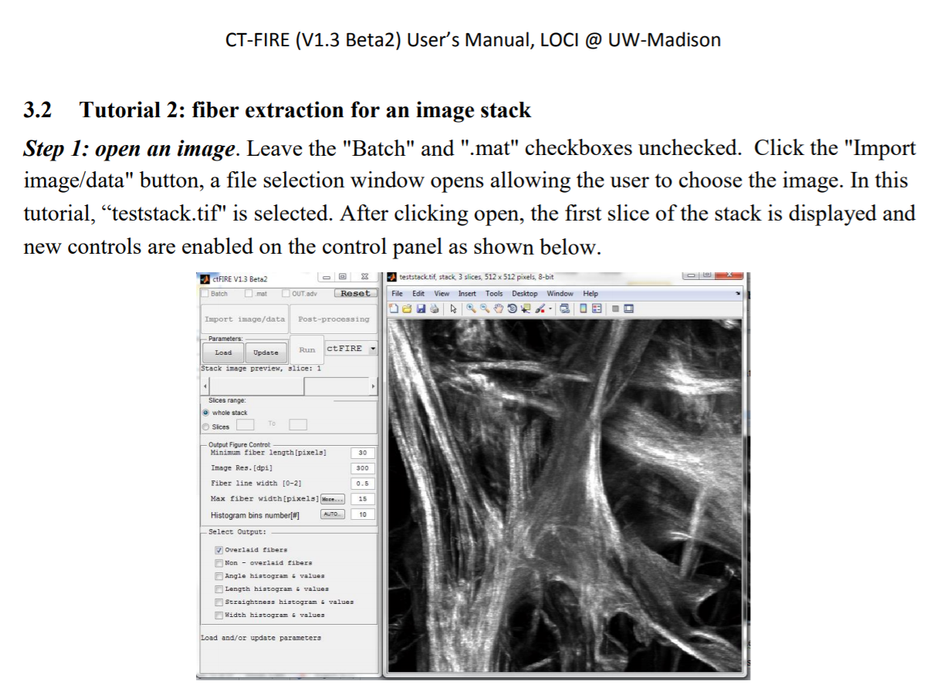
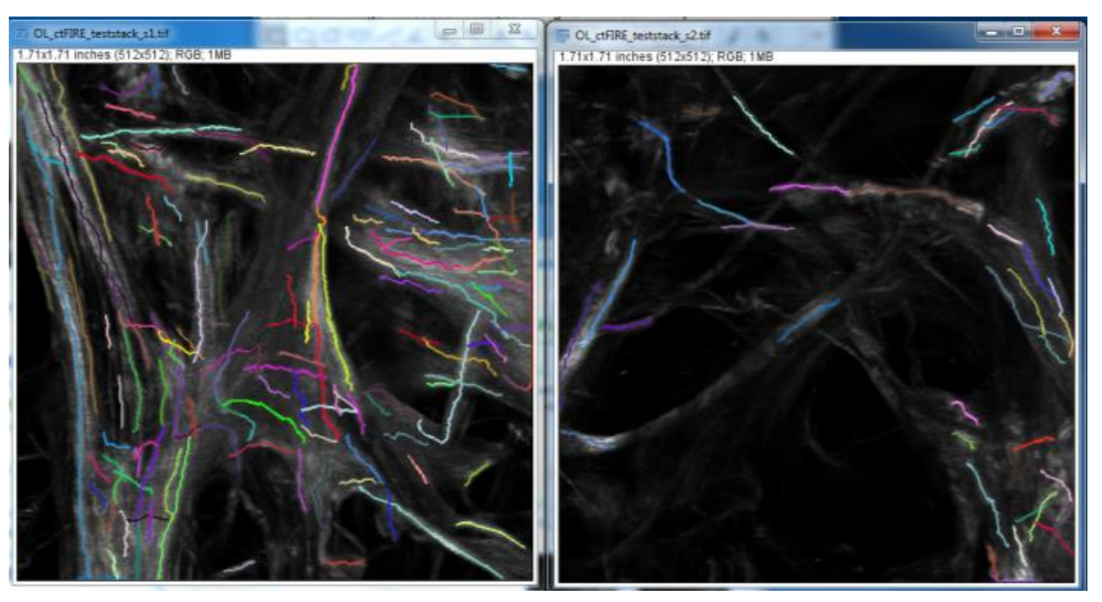
CT-FIRE’s standalone MATLAB application has the capability to process .tiff image stacks

